Slide 1
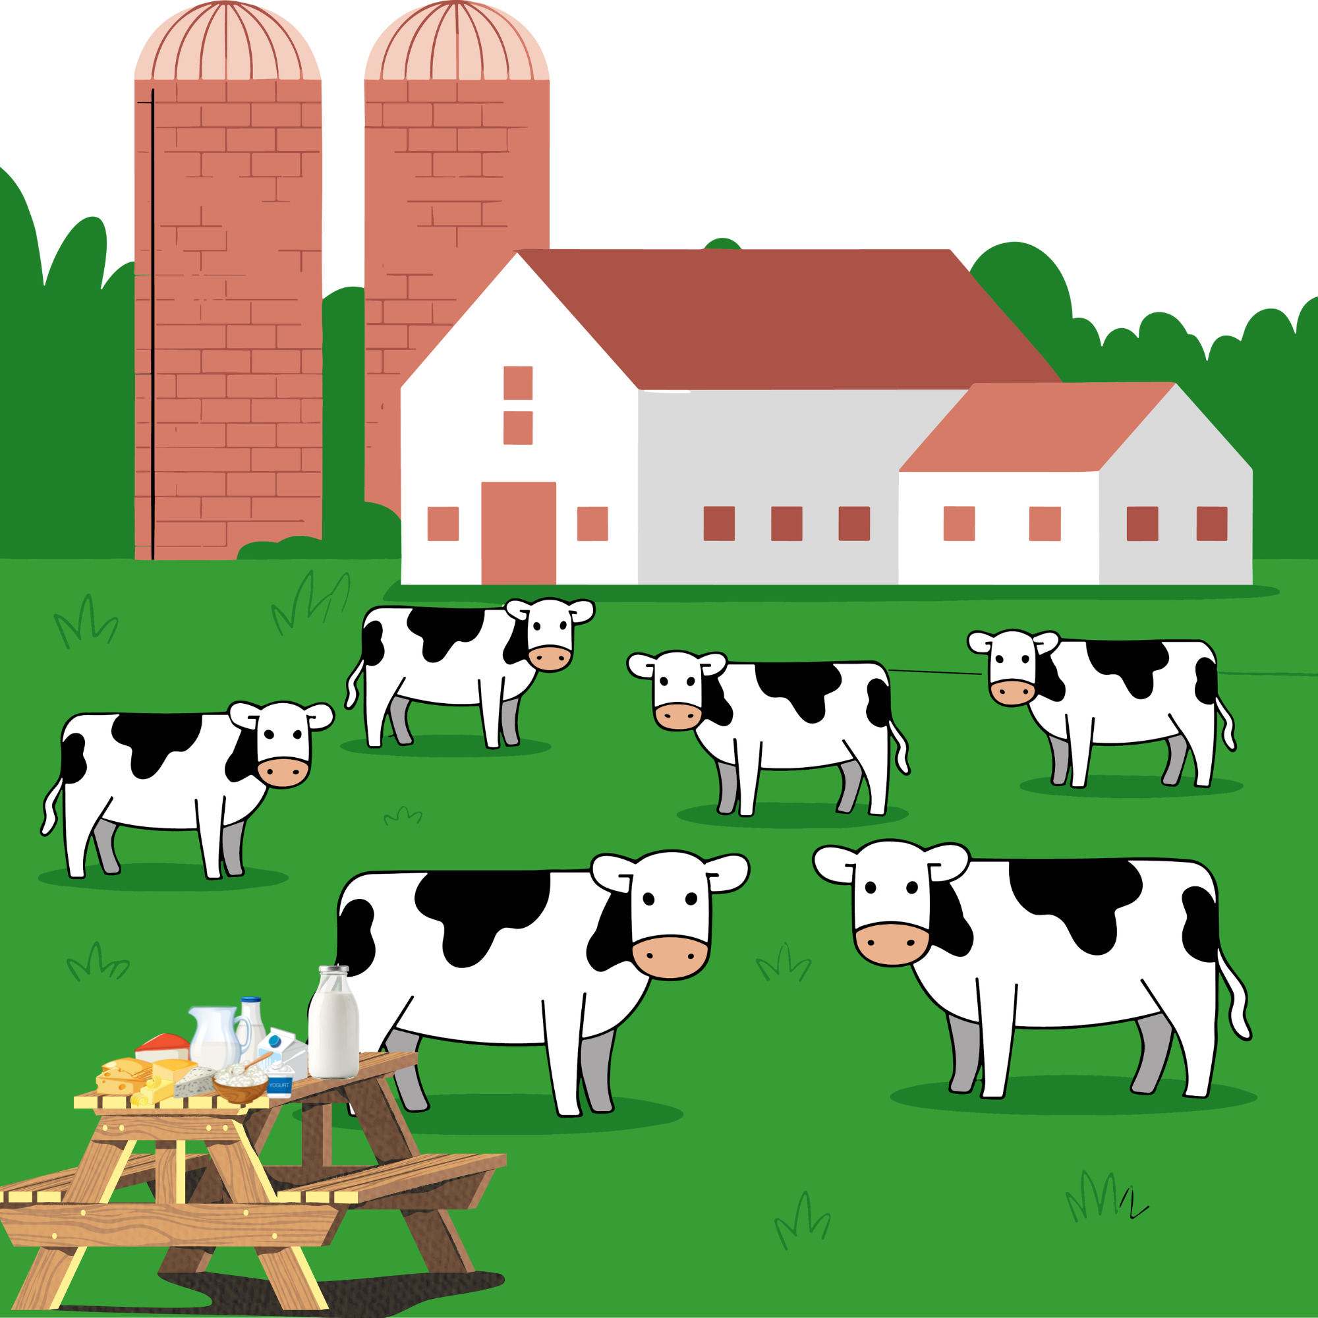

Smart and Sustainable Dairy Production in Bavaria

Slide 2
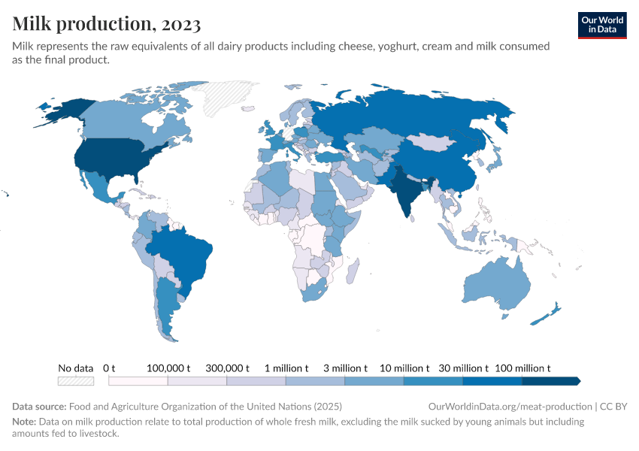
Global Milk Production

Slide 3
Milk Production Perspective
965.7 Mt
Global
EU
32.6 Mt
Bavaria
7.72 Mt
Sources (FAO, LfL, BLE, etc.)

Slide 4
Germany Milk YTD Production ('000 tonnes)

Slide 5
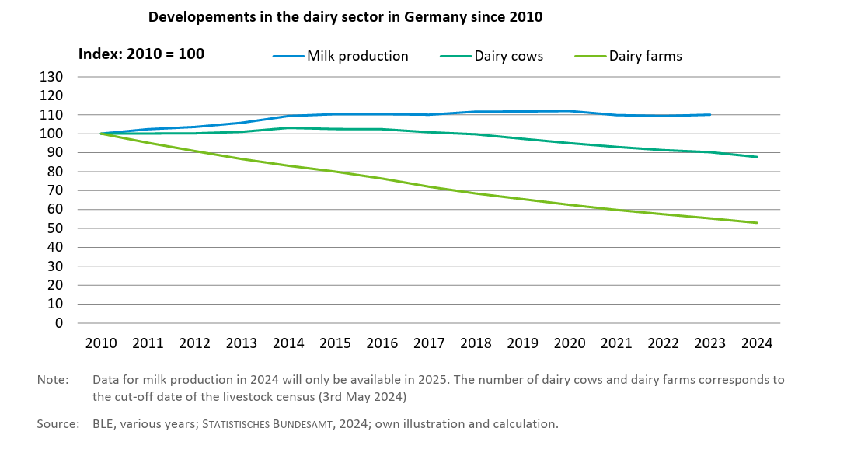
Dairy Sector Developments

Slide 6
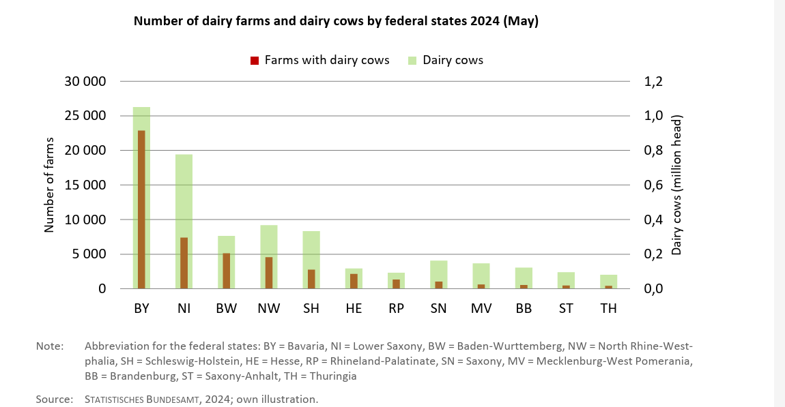
Farm Structure

Slide 7
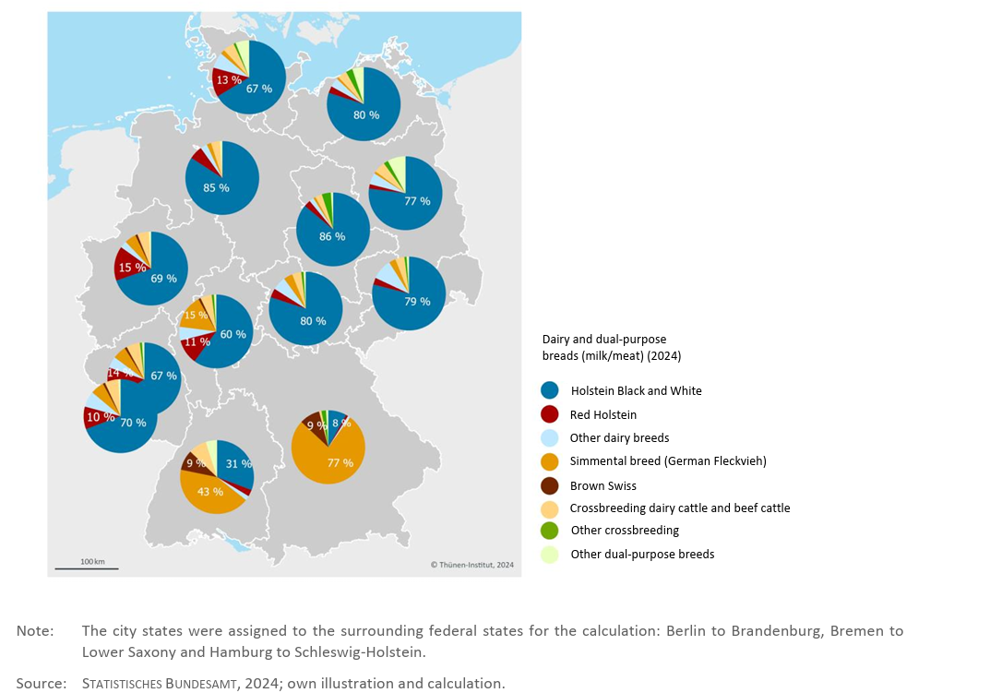
Population Mix- breed

Slide 8
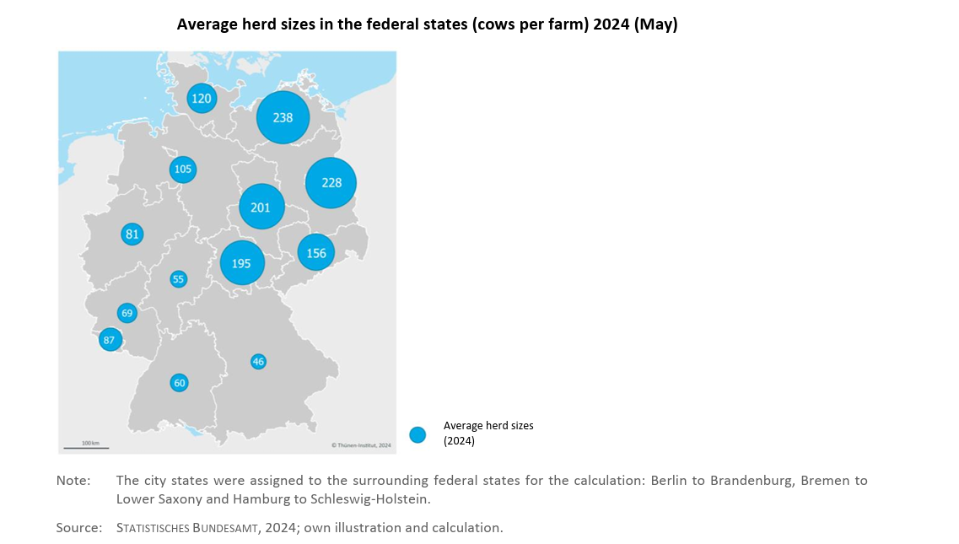
Herd Size

Slide 9
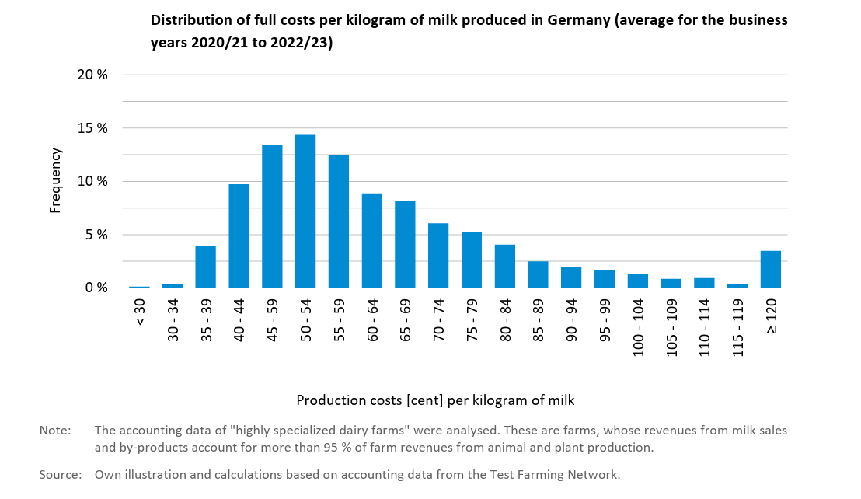
Cost of Productions

Slide 10
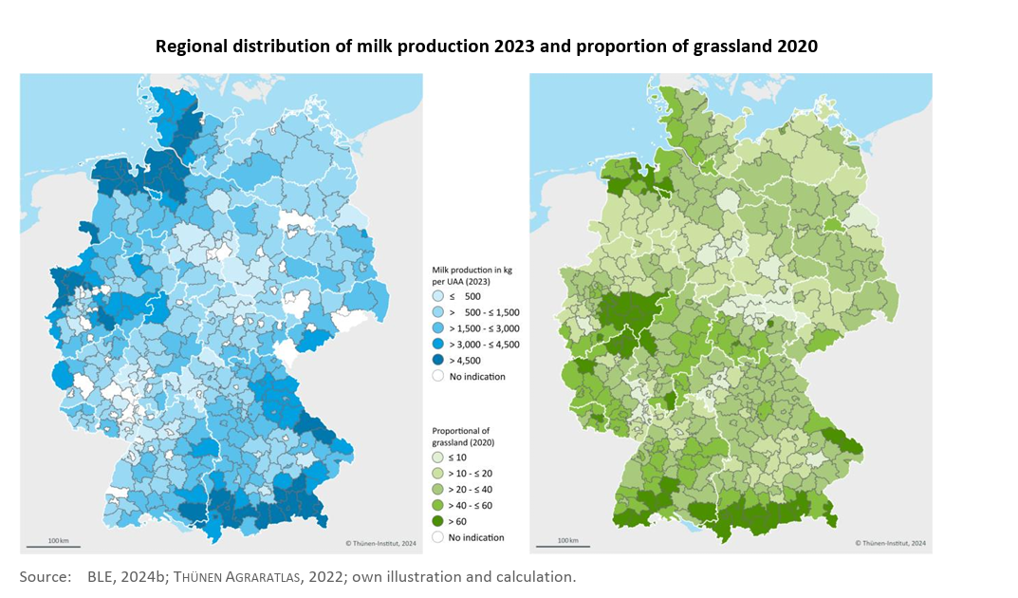
Regional Distribution

Slide 11
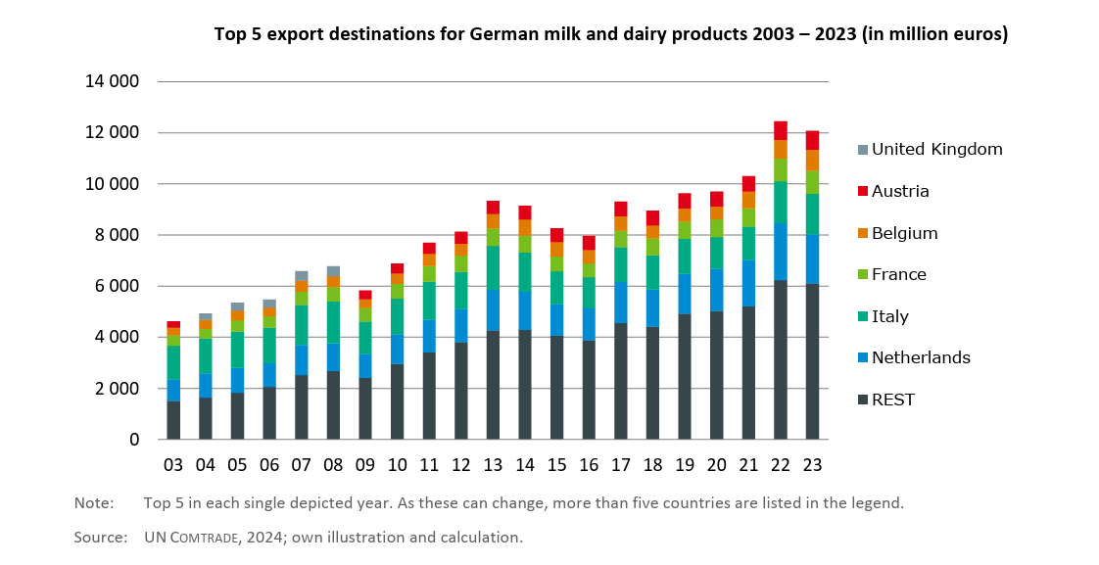
Export

Slide 12
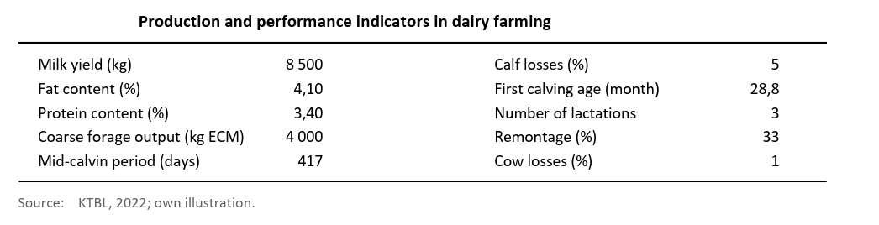
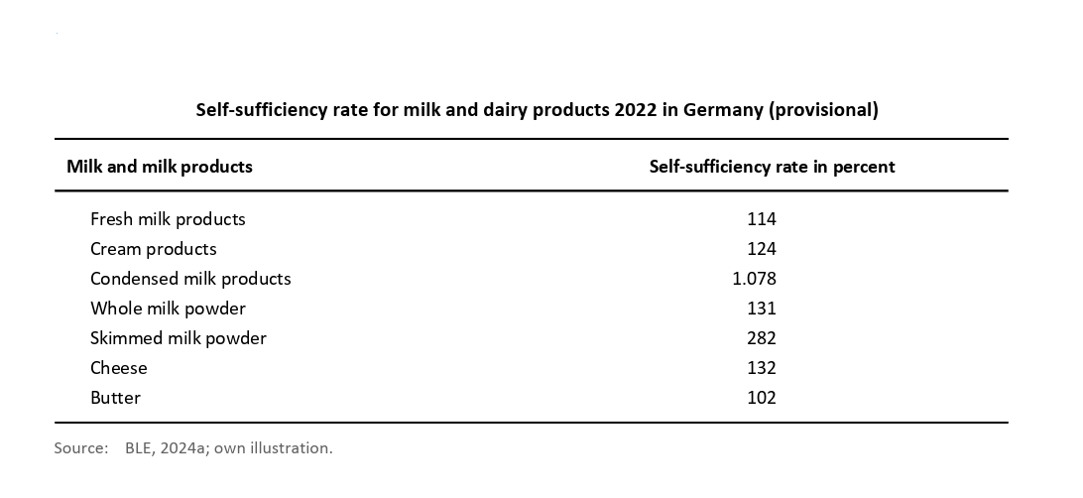
Key Performance Indicators

Slide 13
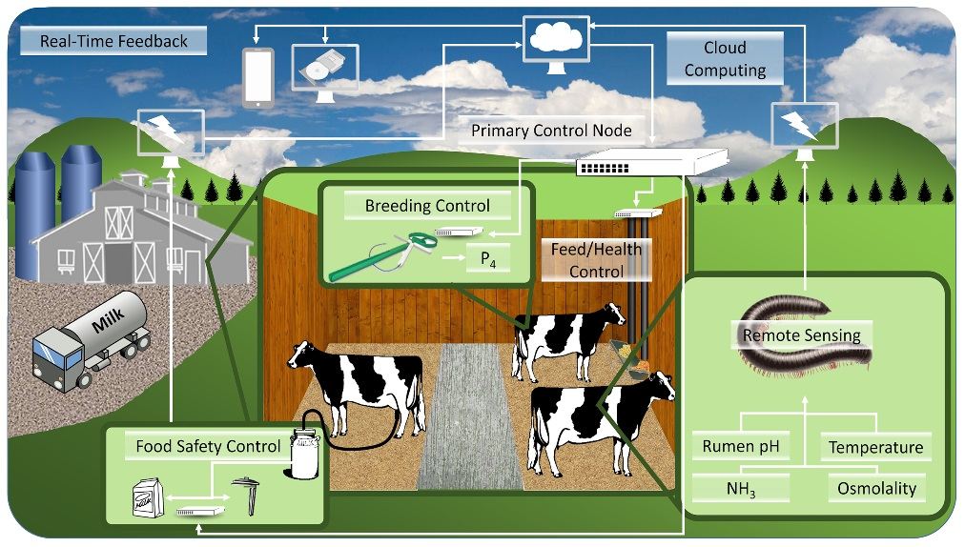
Precision Dairy Farm
Source: https://www.purdue.edu/

Slide 14
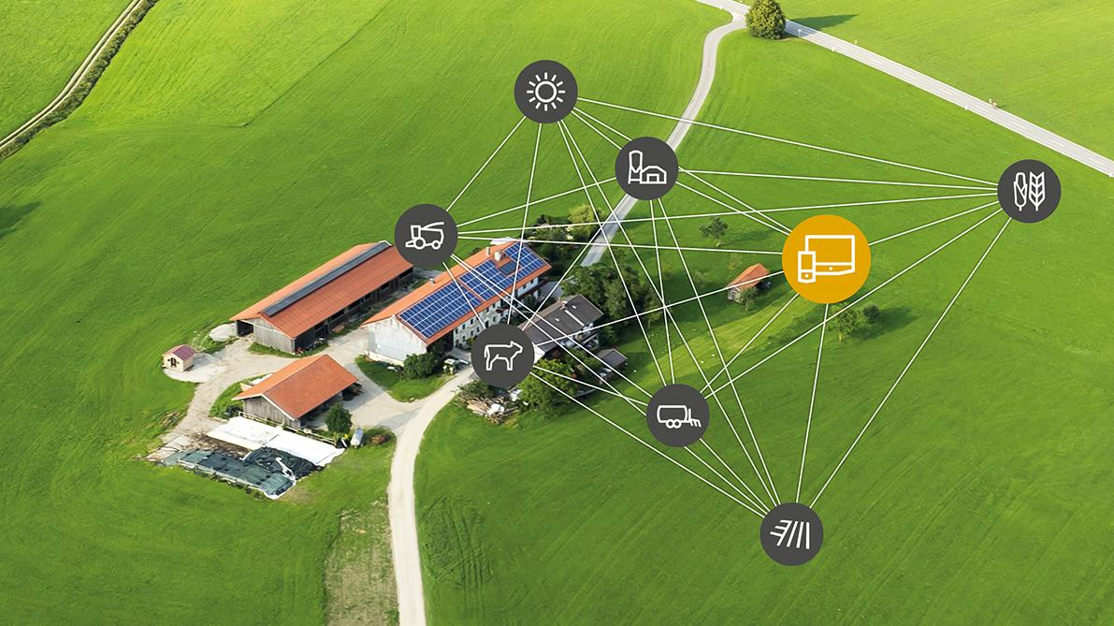


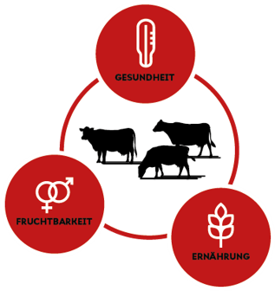


Technology Landscape
Digital Farming
Energy Management
AI
Farm-management platforms

Slide 15
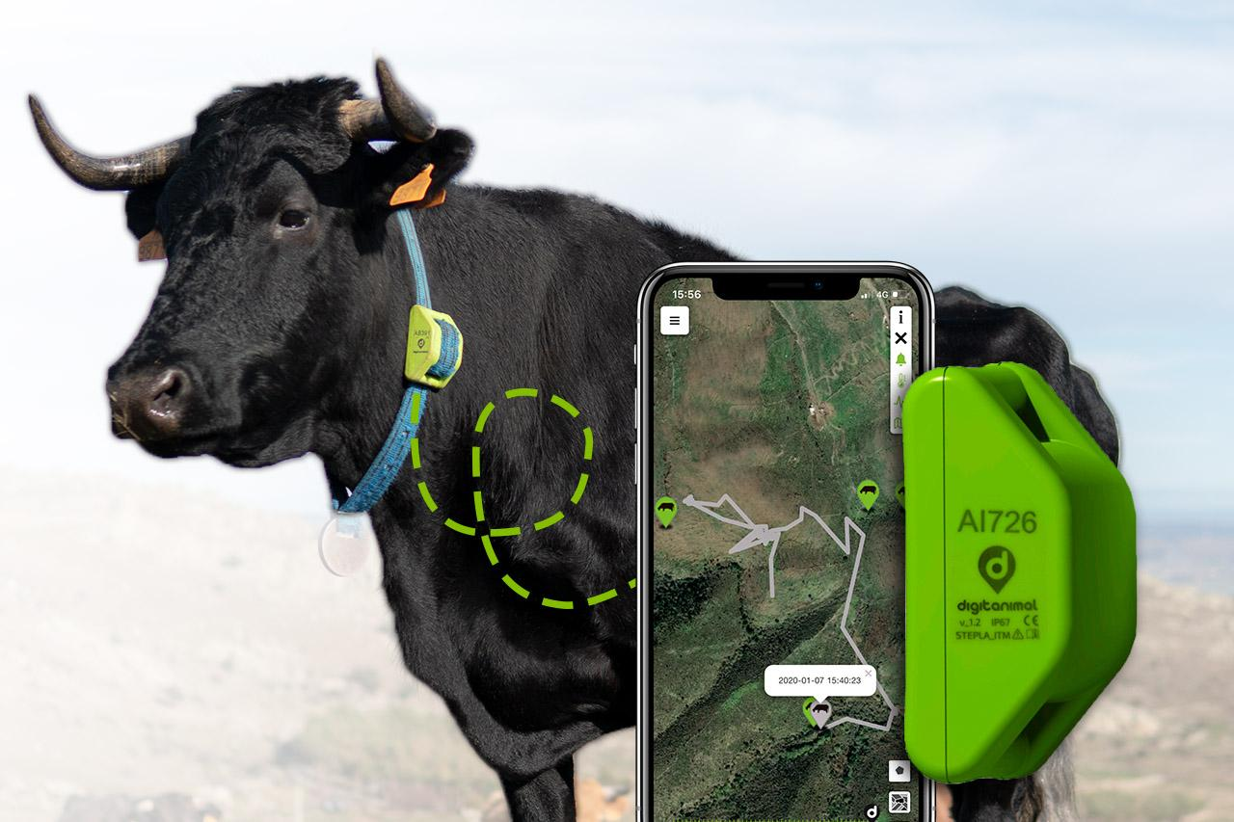
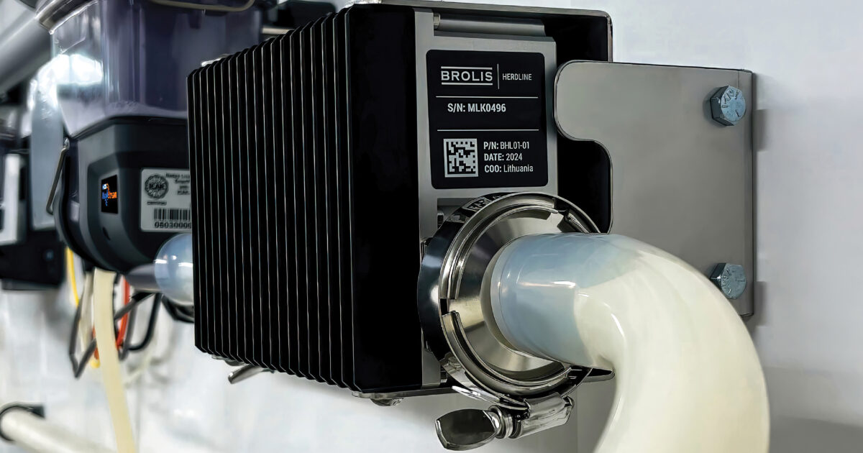
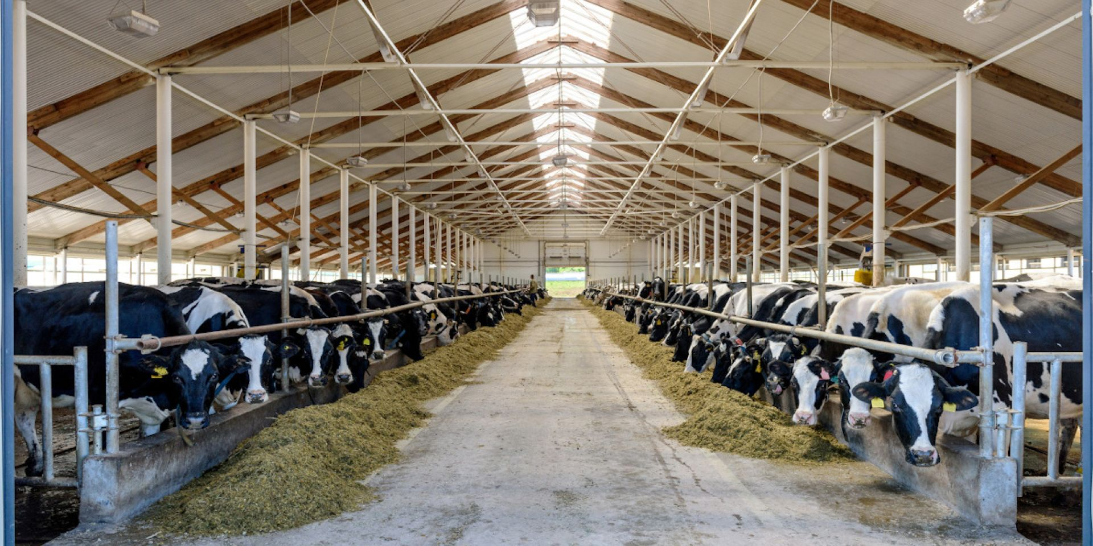
Technology - Deployed
Pedometer collars
Rumination sensors
Ear tags
Location Tags
Milking Robots
Milk Analyzer
Milk Tank Sensor
Temperature
Humidity
Ammonia
Water level
Cameras
Cattle Monitoring
Milk Production
Environment Monitoring

Slide 16
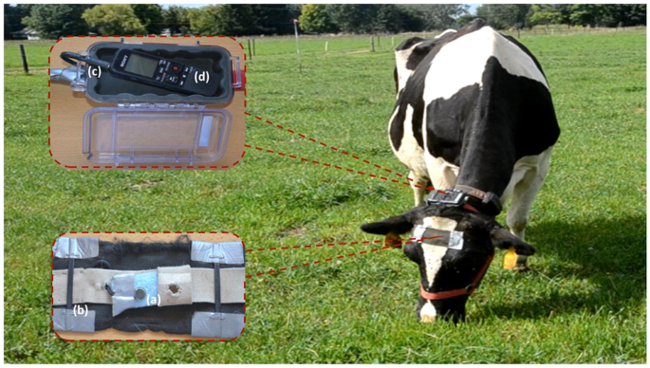
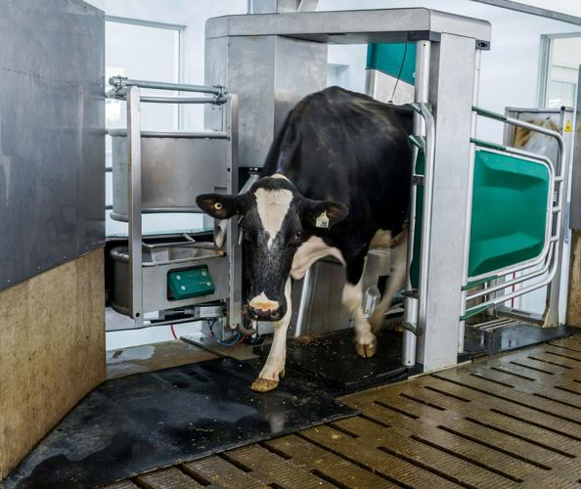
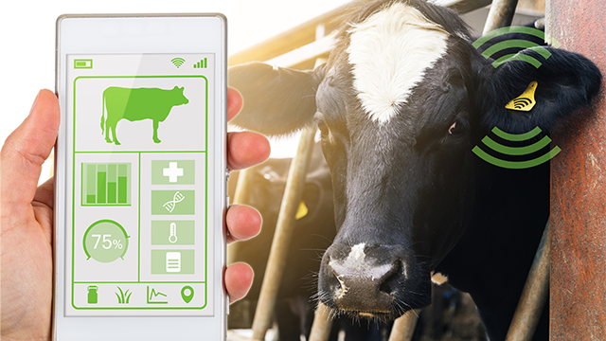
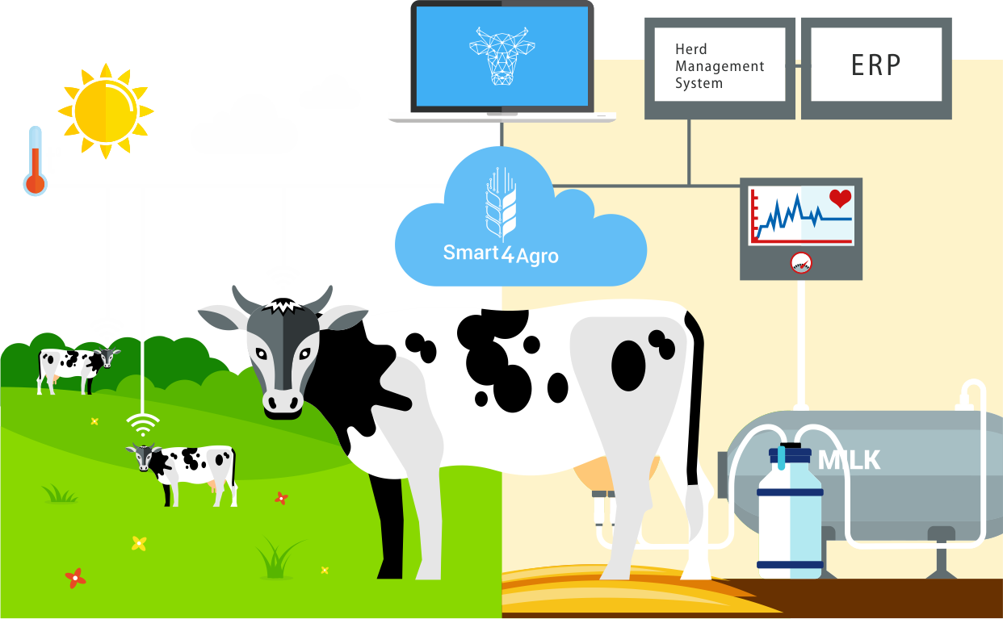
Technology - Potential
Wearables
Early health / heat detection
Milking Robots
More frequent milking
Smart Feeding
Optimal Nutrition
Smart Barn Sensors
Lower Heat Stress
AI Monitoring
Early lameness / BSC checks
Genetics
Better Milk Potential
FMS
Better decisions

Slide 17
Monitoring and Management
Precision Cow Monitoring
Rumination
Eating Patterns
Body Temperature
Activity
Health Anomalies
Farm Management
Health Alerts
Feed Planning
Milking Data Management
Financial Performance Tracker
Camera and AI
Body condition scoring
Lameness detection
Cow positioning and movement
Mastitis early sign

Slide 18
Growth, Health and Safety
Smart Breeding
Artificial Insemination with genomic data
DNA Scoring
Sexed Semen
Environment
Temperature
Ammonia levels
Ventilation
Lighting
Water Management
Robotic scrapper
Smart Feeding
Automated Feed Pushers (Lely Juno)
Automated TMR mixers
RFID based feed systems

Slide 19
Storage and Logistics
Milk Storage
Milk quality monitoring at BMC
Level and volume sensors
UV and Ozone treatmen
Digital Logs
Milk Logistics
GPS and Route optimization for trucks and tankers
Temperature monitoring for spoilage prevention
RFID tagging of milk batches, containers etc.
Robotic scrapper
Data and Analytics
Track milk collection
Storage Duration
Temperature Log
Demand forecasting
Spoilage prediction
Fleet and equipment predictive maintenance

Slide 20
Technology Adoption- Milking Robots
Germany: 48,649 dairy farms in 2024
Accelerated growth (≈15% annual growth)
(50–70%) of new milking-systems are AMS
Source: regional surveys, LfL / TUM / German ag-tech reports

Slide 21
Technology Adoption- FMS
1 in 6 farms (~16%) plan to invest
in digitalization
In 2024, 60% of German farms use
farm management software (FMS)
By 2030, 90% of German farms will use
farm management software (FMS)
Source: regional surveys, LfL / TUM / German ag-tech reports

Slide 22
Challenges
Climate pressure is causing heat stress in cows, resulting in lower milk yield and reduced farm performance.
There is a major labour shortage, and many farmers are aging, making it harder to manage farms efficiently.
Rising production costs for feed, energy, and fertilizer increase financial pressure on dairy farms.
Digital systems like AMS and sensors are often not fully integrated, creating data gaps.
Animal diseases are sometimes detected late, leading to higher treatment costs and milk loss.

Slide 23
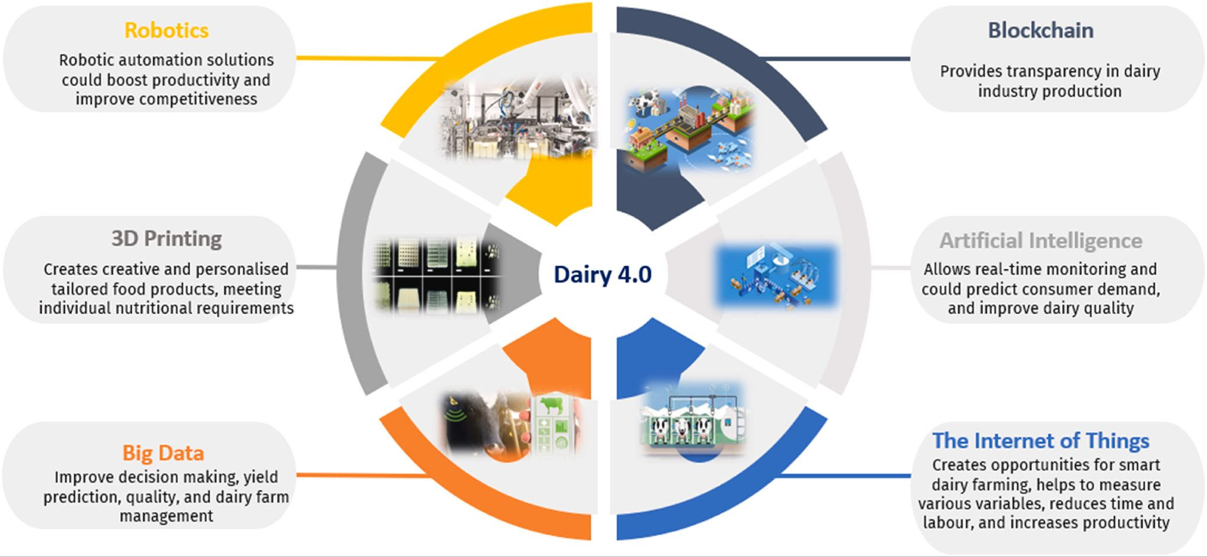
Opportunities
Source: https://www.sciencedirect.com/science/article/pii/S266592712300103X

Slide 24
Thank you

